Slide 1

AstroSage Analysis
ANKAM NAVEEN KUMAR

Slide 2
Agenda
1
2
3
4
5
PROBLEM STATEMENT
DATA DESCRIPTION
DATA CLEANING
ANALYSIS OF OBJECTIVE QUESTIONS WITH KEY METRICS AND VISUALIZATIONS
SUBJECTIVE QUESTION FOR INSIGHTS

Slide 3

Introduction
AstroSage is one of the most authentic astrology destinations for not only those who are seeking astrological assistance, but also for high-level astrological research and development on wide scale
AstroSage has democratized jyotish by introducing which will provide the high-level astrological research and development on wide scale
The Agents will connect with users to provide the solution for the users based on their horoscope and zodiac signs by guiding them what should be done from users side for good cause

Slide 4
PROBLEM STATEMENT
AstroSage has received a 1 crore investment and aims to optimize its call center operations. The goal is to determine how to allocate this investment to maximize operational efficiency, customer satisfaction, and profitability. The analysis will consider historical call data, performance metrics, and market trends to make informed decisions.

Slide 5
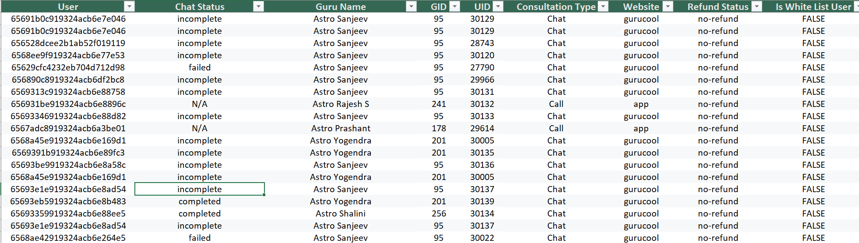
DATA DESCRIPTION
AstroSage Dataset consists of these columns:

Slide 6
DATA DESCRIPTION
_id: Unique identifier for each record.
user: User ID associated with the record.
chat Status: Status of the chat (ex. Completed, incomplete, failed, pending, started)
guru: Profile ID of guru
guruName: Name of the guru
gid: Unique guru ID.
uid: Unique user ID.
consultation Type: Type of consultation (ex. Call, Chat, Live Public calls, Complimentary).
website: Source of the contact or consultation (ex. App, gurucool website).
Refund Status: Indicates if the session is refundable or not (ex. Refunded, no-refund, Processing).
is WhiteList User: Boolean indication of the user is whitelisted.
chat Seconds: Duration of the chat in seconds.
queue: Boolean indication if the session was queued.
FreeCall: Indicating that whether the call service was free or paid.
Free Chat: Indicating that whether the chat service was free or paid.
Created AT: Status of creation date and time.
updatedAt: Status of update date and time.
v: Review Version key.
statementEntryId: Identifier for the statement entry.
chatStartTime: Start time of the chat.
chatEndTime: End time of the chat.
timeDuration: Duration of the chat session.
callChannel: Channel used for the call.
callIvrType: VR type used for the call.
callStatus: Status of the call.
CallSid: Unique identifier for the call session.
amount: Amount charged for the session.
astrologerCallStatus: Status of the astrologer for the call.
astrologerOnCallDuration: Call duration of the astrologer.
astrologersEarnings: Earnings of the astrologer from the session.
netAmount: Net amount after deductions.
region: Region of the user.
userCallStatus: Status of the user's call.
userOnCallDuration: Duration of the user's call.
rating: Rating based on the session from the User

Slide 7
DATA CLEANING
Step 1 : Acquire the data & Understand
Step 2 : Clean the data by modifying the data and fill the blank values by using aggregate excel functions and formatting the data based on the attributes
Step 3: Transform the data by using necessary excel formulas to aggregate the values for the fields that needs to be considered (Text, Sum if, Count if, average, Left, Date & Time, Pivot Table, Charts, filters, Slicers)
Step 4 : After transforming prepare the dashboard by using necessary charts, filters & slicers based on the aggregated values from the data that required
Step 5 : Provide the insights from the values from transformation and dashboard and callout the necessary fields which ever needs to be considered for the objective
Step 6 : Improvements/Suggestions will be provided on the data considering the insights which will eventually help the organization to grow gradually

Slide 8



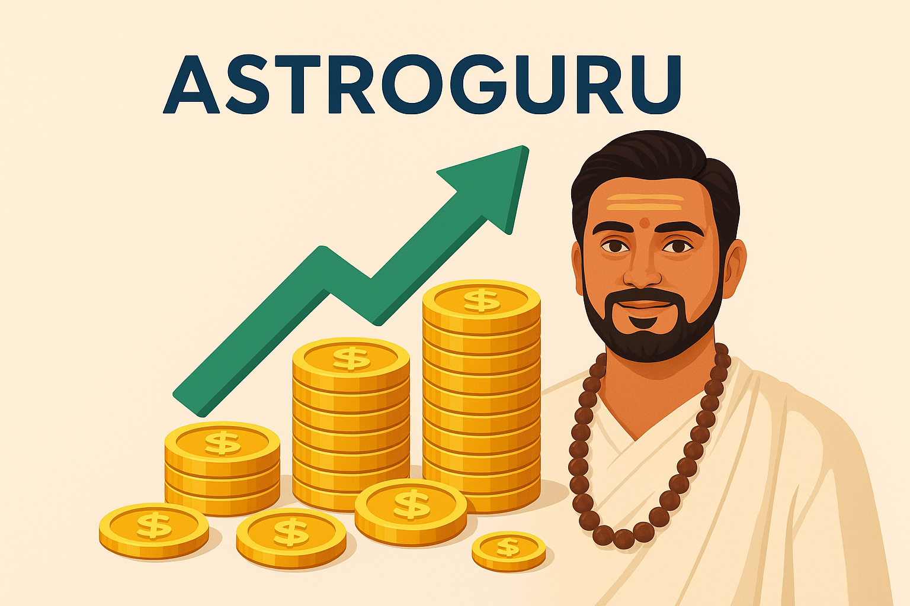
Key Performance Indicator (KPI)
TOTAL USERS
TOTAL ASTROGURU
TOTAL REVENUE
TOTAL EARNINGS
28027
131 (Agents)
213987.31
99147.57

Slide 9
Key Performance Indicator:-
Total Users 28027 are existing
Total 131 Astro Guru’s (Agents) are working
Total Revenue Generated from Users
Total Earnings of Astro Guru’s from Revenue
Total Operational Cost
Overall Call Option used%
Operational cost
114840.74
Overall call %
30.35%
Overall repeated calls 58 %
Repeated users
18519
Single time users
8148

Slide 10
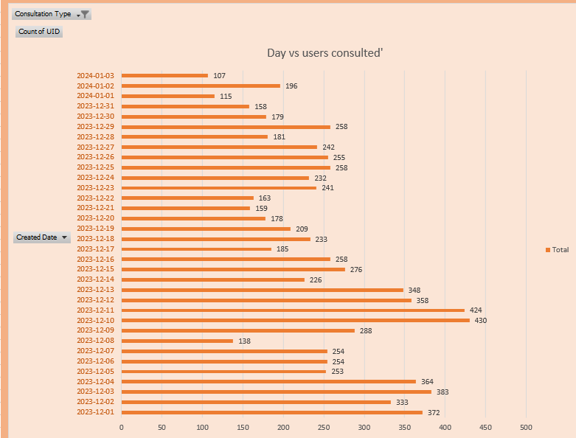
Analysis of calls on each day
Total Calls recorded on daily basis to check the workload of Agents
A total of 8,508 calls were received, including failed, busy, and incomplete ones.
The highest call volumes were recorded on 10th and 11th December 2023.
On peak days, about 45% of calls were completed, and on average, 2 calls per agent per day were handled.
Suggestions:
Hire additional Astro Gurus (agents) to reduce workload and improve call completion rates.
Implement shift rotations so agents are available during peak evening/night hours for users from other regions

Slide 11
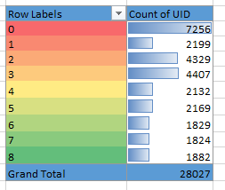
Rating Analysis based on Users Satisfaction for Sessions
High Rating - (5, 6, 7, 8) = 7704 =27.4%
Low Rating – (0, 1, 2, 3, 4) = 20323 = 72.51%
After analysing this above data based on ratings, we can see that around 27.4% were satisfied with the ratings which are par above than usual or average rating and the rest 72.51% were gave their rating 4 or below 4 which below par
Suggestions:
Invest in Astro Guru’s as we received less rating via call options and we can train the chatbots by creating new AI chatbots as well

Slide 12
Call Distribution across the Each hour on all days
Calls Distribution Vs Hours
There is a huge traffic between 6 and 10 in morning and between 14 and 16 during lunch and noon time
Shift Allocation: To overcome this we can have more agents available and even we can start rotating the agents by allocating the shift timings to ensure that all users can be connected to the agents as the bookings happened.
During the night time IST hours we can see that there is no much workload so we can have less number of agents to be available at that time

Slide 13
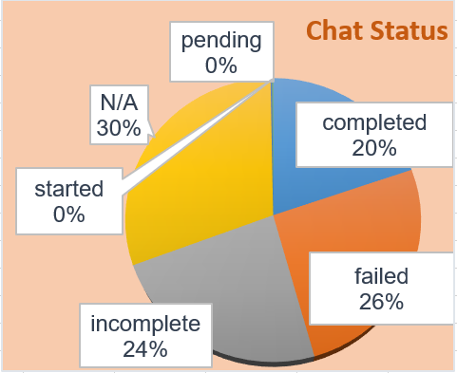
Status of the ChatType
Consulting Type
We can see only 20% calls were completed and rest 80% are in-completed ,pending , failed status.
Suggestions:
We can start training the staff to use the latest systems and technology
RCA needs to be documented for Incomplete chats as we need to improve on those aspects by booking the busy slots accordingly in the free slots to provide the sessions

Slide 14
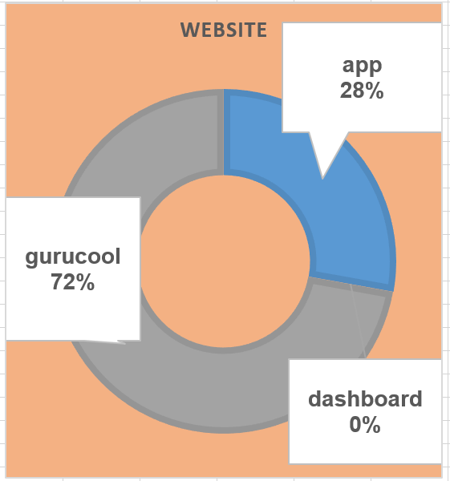
Consultation distributions across all the options available for the Users:
Website distribution:
gurucool = 20225 = 72%
app = 7800 = 28%
dashboard = 2 = 0.000071%
Suggestions:
As gurucool, is only website service which is there for users to connect as it is containing huge load creating traffic we can create alternative services and can be used both in parallel to avoid traffic. It is having the rating as 2.71 where it clearly shows the dissatisfaction from the users. So definitely we should focus on improving the AI chatbots to provide the auto replies to the users which can satisfy the users.

Slide 15
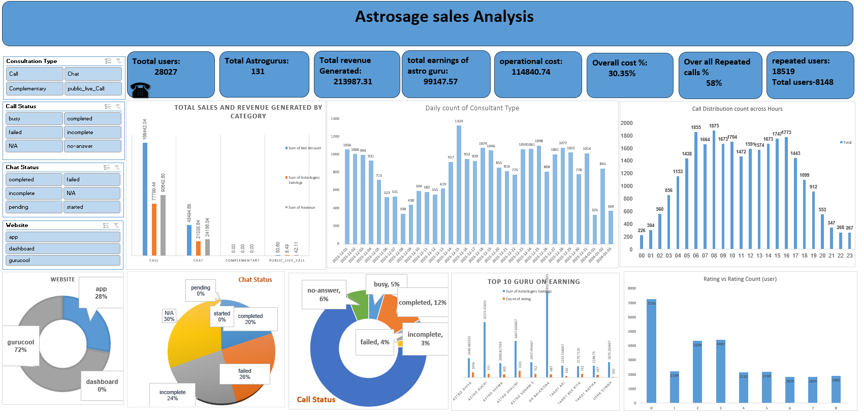
Dashboard

Slide 16
Areas of focus​
1 Cr Needs To Be Invested In These 3 Sectors:
Training & Hiring New agents- 30%
Technology & Upgrading- 45%
Marketing-25%
​
Recruit experienced agents and retain staff by offering bonuses, incentives, and shift allowances.
Upgrade existing Exotel service or explore alternative call center solutions to improve connectivity and efficiency
Promote the organization through offers like discounts, free weekend sessions, premium memberships, and targeted advertising.

Slide 17
Improvements / Suggestions
Training & Hiring New agents which will eventually help the existing agents by improving their knowledge to deliver more good services to existing users in sessions and will help in getting new users to organization which will have the impact on the Revenue generation.
Though ROI will impact but we can retain the existing agents by adding some incentives, bonus and bond period
Technology & Upgrading- We can upgrade the technology and adding the alternative services like call type which will help the users to connect with agents by avoiding the failure or busy scenarios
Marketing- We can start promoting our organization by giving some offers like discounts, and conducting live session for free on weekends, advertising in malls, premium membership with complimentary sessions, discounts for upcoming sessions post completing one or two sessions.

Slide 18

Thank you

